Slide 1
ABLE Achieving a Better Life Experience
Kristin Vandagriff - Planner
Ric Nelson - Program Coordinator

Slide 2
New Federal & State Law ABLE Accounts
Achieving a Better Life Experience (ABLE):
Signed into law by President Obama in 2014
Signed into law in Alaska in August 2016
The ABLE Act is a critical new tool to facilitate employment possibilities:
Allows saving above the Medicaid and Social Security (SSI) Resource Limits!!!
Save money earned without risking necessary public benefits that enable employment in the first place
Reduced reliance on government by allowing a better opportunity for personal savings

Slide 3
Things You Must Know About ABLE
What is an ABLE Account?
Tax-advantaged savings accounts for individuals with disabilities
Income earned by the accounts is not taxed
Contributions to the account are not tax deductible
Tax-exempt savings account:
Similar to 529 college savings account
Recognizes the high cost of living with a disability
Opportunities for financial independence and freedom

Slide 4
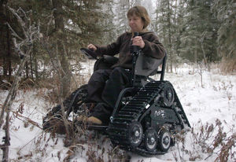
Things You Must Know About ABLE
Why is there a need for ABLE accounts?
Previously, public benefit eligibility required an individual to remain at or below poverty levels
ABLE savings accounts will not affect eligibility for SSI, Medicaid/other federal public benefit programs!
There are extra costs of living with a disability

Slide 5
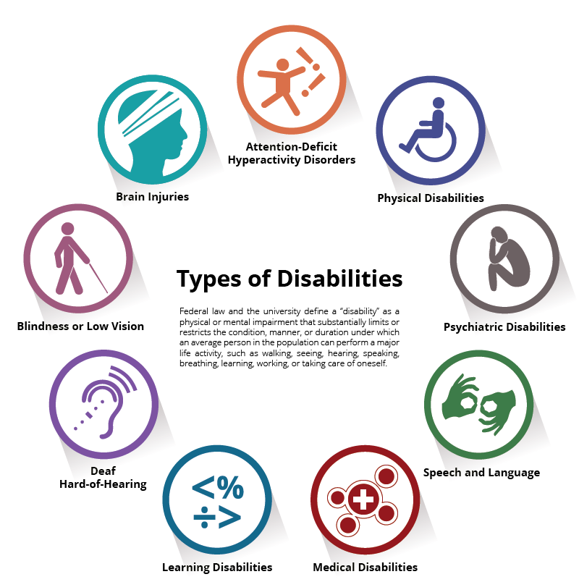
Things You Must Know About ABLE
Am I eligible for an ABLE account?
Eligibility=individuals with significant disabilities
Age of onset before turning 26 SSI and/or SSDI = automatically eligible
No SSI and/or SSDI? Still eligible if you meet SSI criteria
Significant functional limitations
Can be under 26 or over 26
If over 26, documentation of onset needed
Proof of eligibility is on the individual
and the IRS, not the state
Infographic design by WWW.LvuDesign.com

Slide 6
Things You Must Know About ABLE
Are there financial limits for ABLE Accounts?
Total annual contributions = $15,000
Amount will be adjusted annually for inflation
Gift Tax Exclusion: $15,000 = maximum amount individuals can give & not pay taxes
Up to an additional $12,060 for employed account holders (only the individual)
State of Alaska Total limit over time = $400,000
SSI/Medicaid recipients = exempt from resource limit up to $100,000
Exceeding $100,000 = loss of SSI eligibility/benefits
Medicaid eligibility continues, however….

Slide 7
Things You Must Know About ABLE
What can ABLE Account funds be used for?
Qualified disability expenses, related to the individual’s disability and made for his/her benefit, including:
Education
Housing
Transportation
Legal Fees
Employment training and support
Assistive technology and personal support services
Health prevention and wellness
Financial management and administrative services
Expenses for oversight and monitoring
Funeral and burial expenses
Any other expenses approved by the Secretary of Treasury
*Non-qualified expenditures can be penalized (Tax and SSI Penalties)

Slide 8
Things You Must Know About ABLE
Can I have more than one ABLE Account?
-NO!
The ABLE Act limits the opportunity to one ABLE account per eligible individual

Slide 9
Things You Must Know About ABLE
Will states offer options to invest the savings contributed to an ABLE account?
- YES!
Similar to state 529 college savings plans
Investment changes = two opportunities per year.

Slide 10
Things You Must Know About ABLE
How is an ABLE Account different than a special needs or pooled trust account?
More choice and control
Low startup costs
Account owner ability to control
funds
ABLE Accounts and Special Needs Trusts Can Be a Winning Combination: http://ablenrc.org/news/able-accounts-and-special-needs-trusts-can-be-winning-combination

Slide 11
National ABLE Resource Center (ANRC)
The main ABLE National Resource Center website is: http://ablenrc.org/
To learn more regarding many different ABLE account topics discussed via ANRC webinars, visit: http://ablenrc.org/webinars
The “News” section has lots of great topic specific information: http://ablenrc.org/news

Slide 12
The Road Map to Enrollment:
http://ablenrc.org/road-map-enrollment

Slide 13
ABLE Age Adjustment Bill Reintroduced in U.S. Senate
The ABLE Age Adjustment Act will expand the number of individuals with disabilities eligible to open ABLE accounts.
Under current law, only individuals with an age of onset of disability prior to turning 26 are eligible.
S. 651 would increase the age limit up to 46 years of age, providing any individual whose disability onset began prior to turning 46 the opportunity to open an ABLE account.
This important change will not only expand access for individuals with disabilities, but improve the long-term viability of ABLE programs by expanding the number of active accounts.
http://ablenrc.org/news/able-age-adjustment-bill-reintroduced-us-senate

Slide 14
ABLE to Work
I am working and earning income – can I contribute more than the $15,000 limit?
Yes - ABLE account owners who earn income may exceed the annual $15,000 contribution limit. The additional annual contribution amount allowed is equal to the federal poverty level for a one-person household (in your state of residence) or the account owner's gross wages, whichever is less.
Individuals may not be eligible if they are already contributing to their retirement through:
a defined contribution plan
an annuity contract
an eligible deferred compensation plan
Account Owners should keep adequate records to ensure the limit is not exceeded. Any increase in contributions could impact tax obligations, so consult a tax advisor before making any such increase. If you are eligible, fill out the Self Certification form.

Slide 15
Can I rollover a 529 College Savings Plan into my ABLE account?
Yes, as of 2018 Congress passed the ABLE Financial Planning Act which allows you to rollover money from a 529 College Savings account into a beneficiary’s (or family member’s*) ABLE account without being penalized.
There is a $15,000 rollover limit (less the current tax-year ABLE contributions).
You can use the appropriate 529 College Savings to ABLE Rollover Form.*
The family member must be considered a qualified “Member of the Family” as defined by the 529 College Savings Plan, which includes: biological and step parents, aunts, uncles, siblings, children, first cousins, nieces and nephews; parents, siblings, children, nieces and nephews by marriage; legally adopted children; and half-brothers or half-sisters) of the 529 College Savings account Beneficiary.
https://ableforall.com/faqs

Slide 16
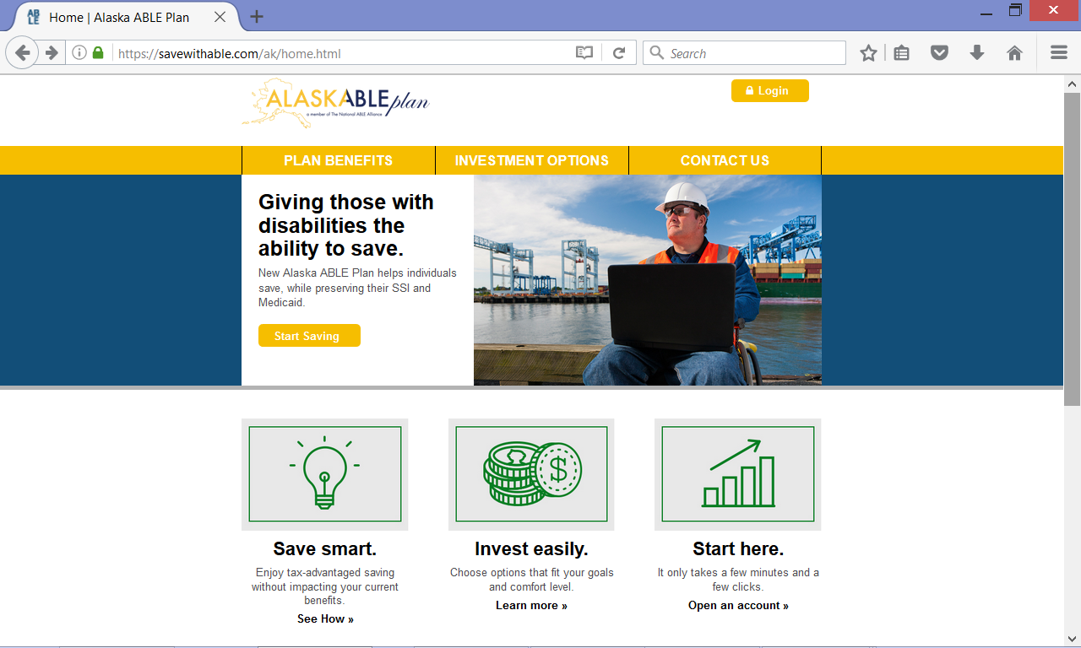
Alaska ABLE Account Website
https://savewithable.com/ak/home.html

Slide 17
Questions?

Slide 18
Contact Information:
Toll Free: 1 (888) 269-8989 From Anchorage: (907) 269-8989 Fax: (907) 269-8995
550 W 7th Ave, Suite 1230
Anchorage, Alaska 99501
http://dhss.alaska.gov/gcdse/

